Slide 1
APB PROTOCOL
BY SRAVANTHI
Chipweave technologies pvt lmd

Slide 2
contents
Introduction to APB protocol
Block diagram
AMBA APB Signals
State diagram
APB Transfers

Slide 3
Introduction to APB Protocol
APB stands for Advanced Peripheral Bus and it is the member of AMBA(Advanced Microcontroller Bus Architecture) protocol family
It is a low-cost interface, optimized for minimal power consumption and reduced interface complexity.
The APB interface is not pipelined and is a simple, synchronous protocol. Every transfer takes at least two cycles to complete.
APB can interface with the AXI and AHB protocols through the Bridge
​

Slide 4
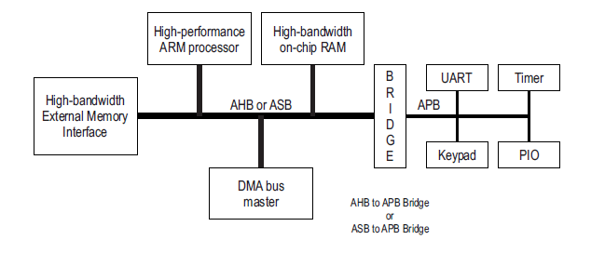
Block Diagram

Slide 5
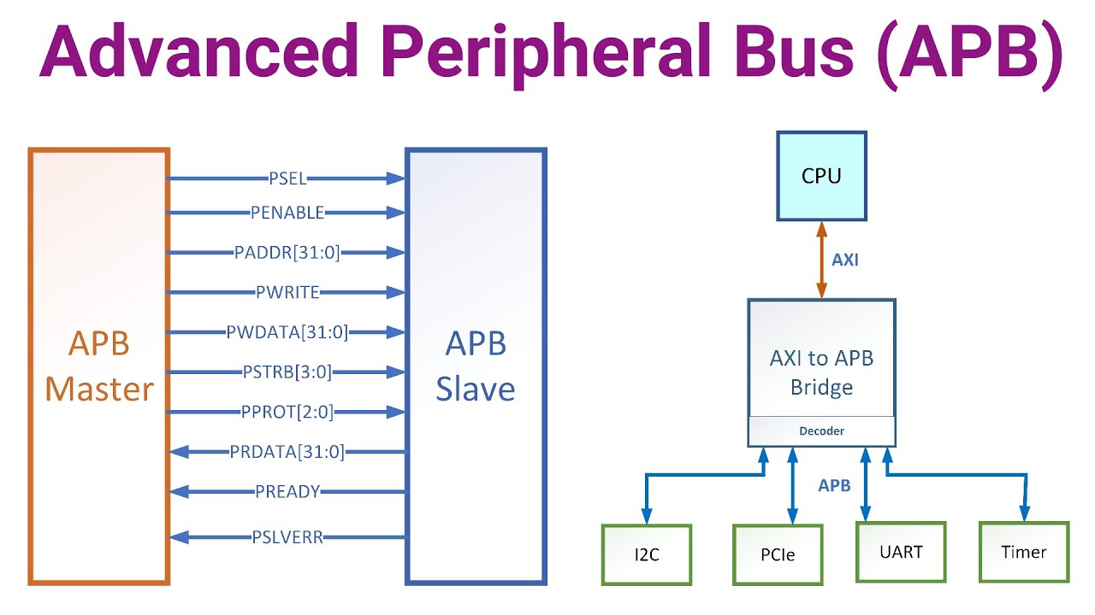
AMBA APB Signals

Slide 6
APB Signals
1.PCLK : PCLK is a clock signal.
All APB signals are timed against the rising edge of PCLK.
2. PSELx : Select
The Requester generates a PSELx signal for each Completer. PSELx indicates that the Completer is selected and that a data transfer is required.
3. PRESETn: Reset signal.
PRESETn is the reset signal and is active-LOW. PRESETn is normally connected directly to the system bus reset signal.
4. PENABLE : Enable
PENABLE indicates the second and subsequent cycles of an APB transfer.

Slide 7
APB Signals
5. PADDR: ADDR_WIDTH
PADDR is the APB address bus. PADDR can be up to 32 bits wide.
6. PWRITE : Direction
PWRITE indicates an APB write access when HIGH and an APB read access when LOW.
7. PWDATA : DATA_WIDTH Write data
The PWDATA write data bus is driven by the APB bridge Requester during write cycles when PWRITE is HIGH. PWDATA can be 8 bits, 16 bits, or 32 bits wide.
8. PRDATA: DATA_WIDTH Read data
The PRDATA read data bus is driven by the selected Completer during read cycles when PWRITE is LOW. PRDATA can be 8 bits, 16 bits, or 32 bits wide.

Slide 8
APB Signals
9. PREADY : Ready.
PREADY is used to extend an APB transfer by the Completer.
10. PSLVERR : Transfer error.
PSLVERR is an optional signal that can be asserted HIGH by the Completer to indicate an error condition on an APB transfer.
11. PSTRB : DATA_WIDTH/8 Write strobe.
PSTRB indicates which byte lanes to update during a write transfer. There is one write strobe for each 8 bits of the write data bus.
PSTRB[n] corresponds to PWDATA[(8n + 7):(8n)]. PSTRB must not be active during a read transfer

Slide 9
APB Signals
12. PPROT[2:0] : Protection type.
PPROT[0] indicates the normal or privileged
PPROT[1] indicates the secure protection level of the transaction or not.
PPROT[2] indicates whether the transaction is a data access or an instruction access.
13. PNSE : Extension to protection type.
PNSE must be valid when PSEL is asserted.
14. PWAKEUP : Wake-up.
PWAKEUP indicates any activity associated with an APB interface.
It provides a glitch-free signal that can be routed to a clock controller, or similar component, to enable power and clocks to connected components.

Slide 10

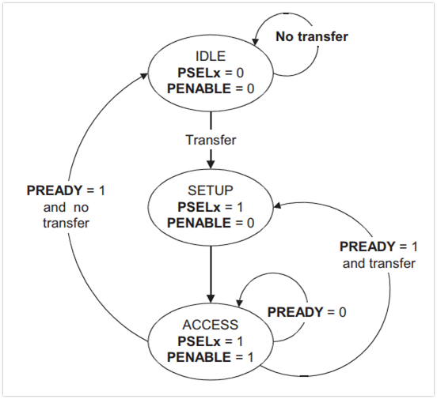
State Diagram

Slide 11
APB Transfers
Types of Transfers
  Write Transfer: Master sends data to the slave.
  *write transfer with and without wait states
  Read Transfer: Master receives data from the slave.
  *Read transfer with and without wait states
  Idle: No transfer occurring.

Slide 12
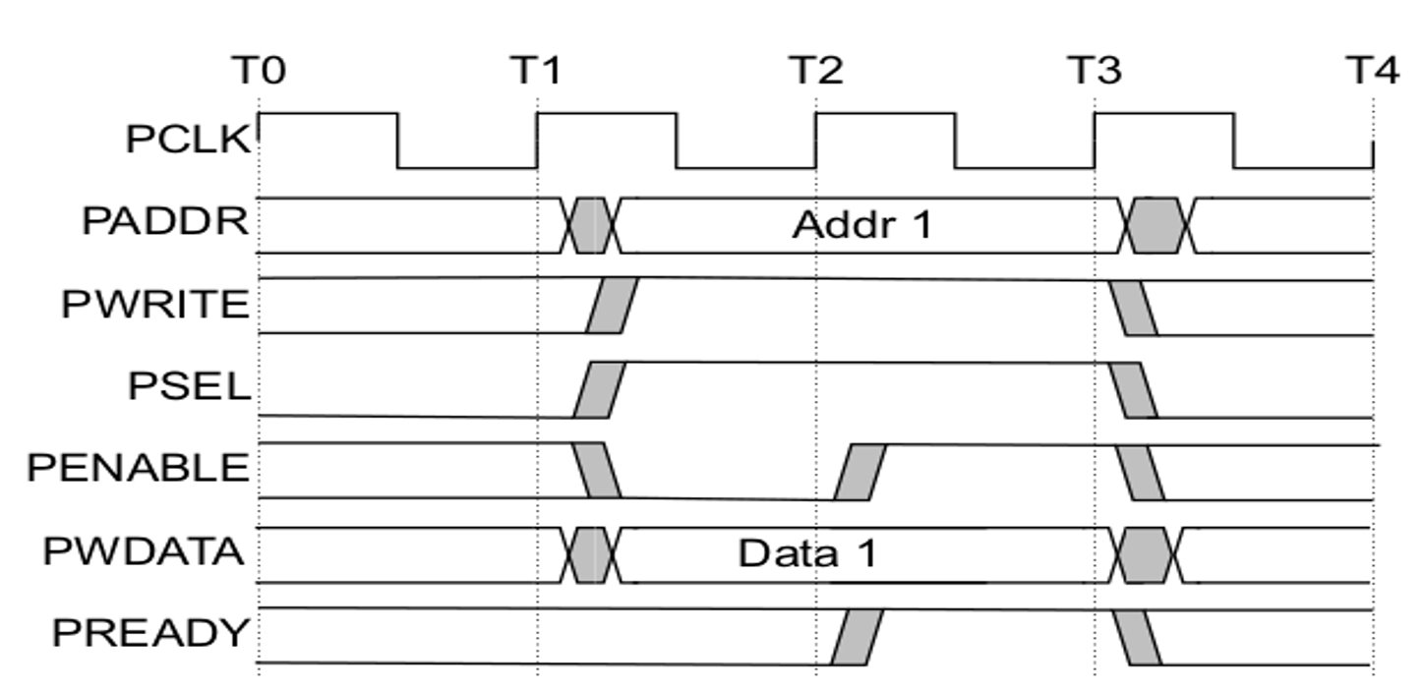
Write transfer with no wait states

Slide 13
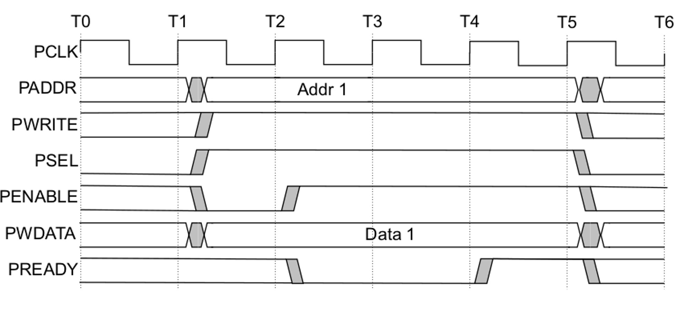
Write state with wait states

Slide 14
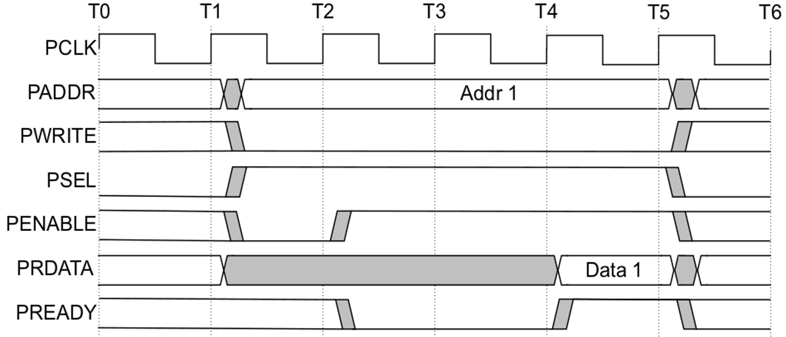
Read transfers with wait states

Slide 15
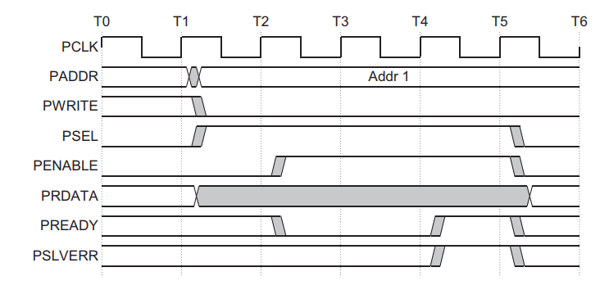
Error response for a read transfer

Slide 16
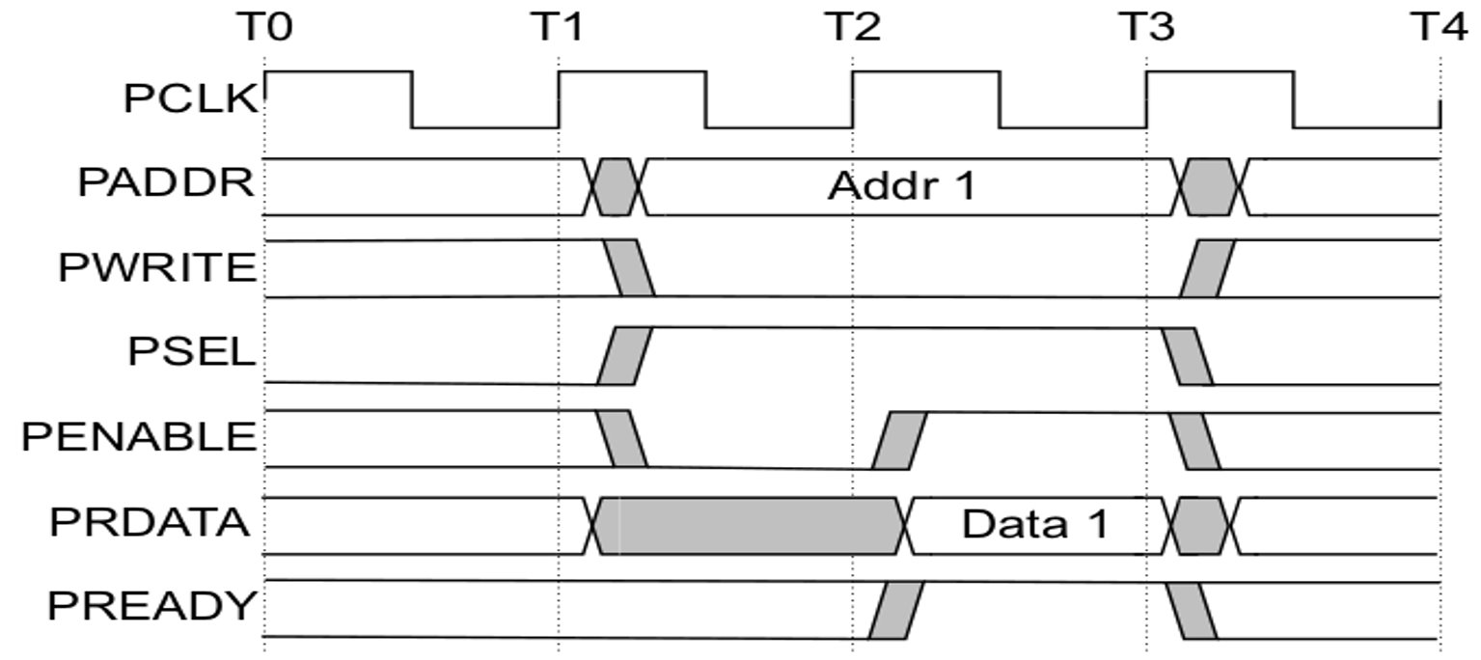
Read transfer with no wait states

Slide 17
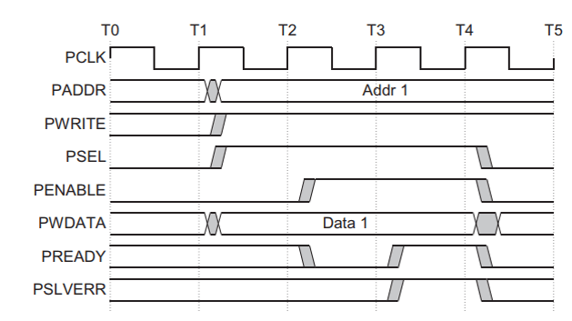
Error response for write transfer

Slide 18


